Slide 1
Immunotherapy for primary mediastinal large B cell lymphoma PMBCL
Dr. Aya Alsyaleh
Hematologist
Damascus hospital

Slide 2
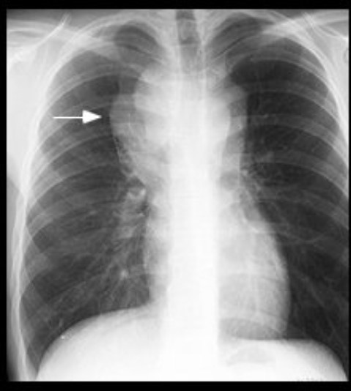
Primary mediastinal large B cell lymphoma
Is an aggressive large B cell lymphoma arise from thymic (medullary) B cells.
7% of DLBCL, female predominance (30-40 years).
Present with frequent airway compromise & SVC syndrome (up to 80% ), Pleural or pericardial effusion.
¾ of patients have stage 1 or 2 at diagnosis, Primary tumor >10cm (50%).
It has clinicopathologic features distinct from DLBCL and shares some features with Nodular sclerosis hodgkin (cHL).
Typically express pan-B cell antigens, weak expression of CD30, frequently express MAL-1 and CD200, rarely express CD15.

Slide 4
Observation vs. radiotherapy in PMBCL patients with complete response to standard immunochemotherapy: The IELSG37 randomized trial.
CMR was defined, upon central review of (PET/CT) scans, as Deauville score 1 to 3, according to the Lugano classification
Induction immunochemotherapy was completed and response assessed in 530 patients, 268 of them (50.6%) achieved a CMR and were randomly allocated to OBS (n = 132) or RT (n = 136).
The PFS at 30 months was 98.5% (95%CI, 94.3 – 99.6) in the RT arm and 96.2% (95%CI, 91.1-98.4) in the OBS arm (P = 0.278).
The estimated relative effect of radiotherapy vs observation in terms of hazard ratio (HR) was 0.47 (0.12-1.89) without adjustments and 0.79 (0.19-3.31) after stratification for the variables used for randomization.
The absolute risk reduction from RT was 2.3% (-1.5 to 6.2) unadjusted, and 0.8% (-3.0 to 8.3) with stratified HR.
The 5-year overall survival was 99% in both arms. Longer follow-up is needed to examine late toxicity

Slide 5
Survival Patterns of Non-Randomized Patients in the IELSG37 Study: Deauville Score 4 Is Not Necessarily Associated with Poor Outcome in PMBCL.
Here we present the outcome of the 262 patients who were not randomized and were managed according to the preference of their treating physician.
In the DS4 group, 12 patients were observed, 149 had only RT, and 13 had second-line chemotherapy, with (12) or without (1) autologous stem cell rescue, 8 of 13 also had RT.
Among the patients with DS5, only 2 were observed, 32 had only RT, and 22 had second-line chemotherapy, with (15) or without (7) autologous stem cell rescue; 12 of them also had RT.
The outcome of patients with DS4 was overlapping the one of the patients achieving a CMR, with 3-year PFS of (97.1%) and ( 97.4%), respectively, while patients with DS5 had a significantly poorer 3-year PFS (62.4%, 95%CI 48-74) .

Slide 6
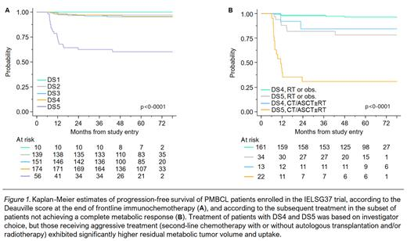
Patients with DS4 had outcomes similar to those of patients achieving a CMR, indicating that this group may either include a significant number of “false-positive” cases with inflammatory uptake or that their residual disease is limited and can potentially be cured with consolidation RT.
Patients with DS5 had a significantly poorer outcome, although nearly half of them did well with RT alone.
Further studies are needed to investigate whether PET metrics and/or liquid biopsies can aid in personalizing treatment and identifying patients who could potentially avoid irradiation

Slide 7
High PDL1/PDL2 gene expression correlates with worse outcome in PMBCL:
Among all 137 markers tested for correlation with survival data, only PDL1 and PDL2 expression levels had a prognostic impact
By correlating the GEP of PMBLs with outcomes, we highlight a subset of cases highly expressing both the PDL1 and PDL2 immunosuppressive genes, representing ∼23% to 30% of cases.
This group of patients is at high risk of chemotherapy failure because of the specific immune privilege conferred by the high PDL1/PDL2 gene-expression profile.
In multivariate analyses, only PDL1^{high/}PDL2^{high} status was an independent prognostic factor of outcomes.

Slide 8
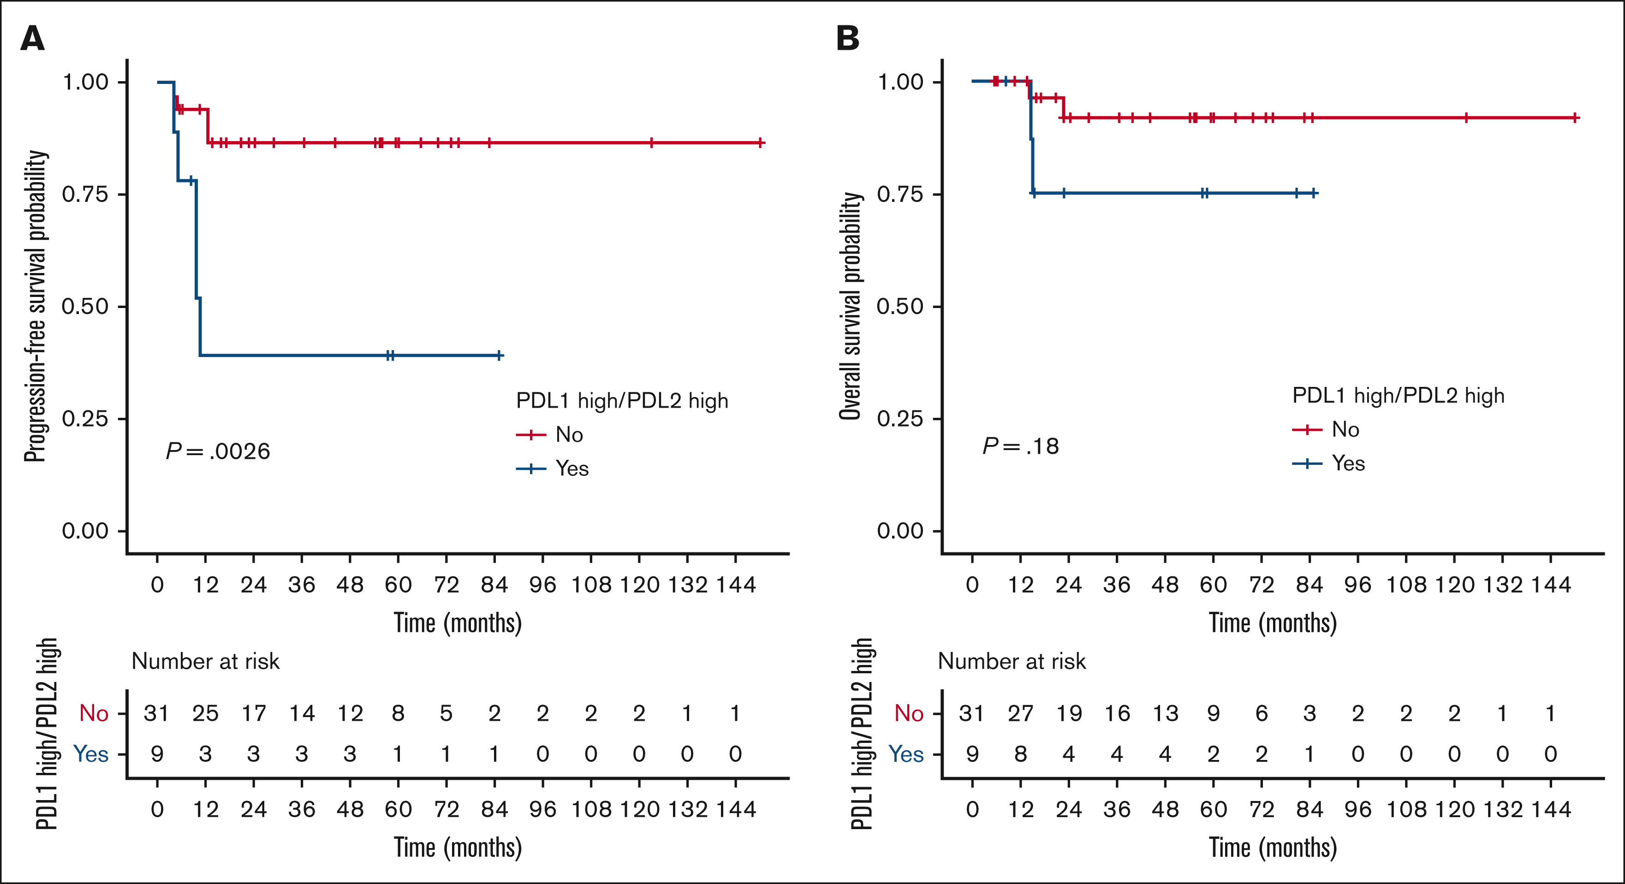
Overall, the 2-year PFS rate in the PDL1^{high/}PDL2^{high} group was estimated at 78.1% vs 93.8% for other patients and the 2-year OS rate in the PDL1^{high/}PDL2^{high} group was estimated at 83.2% vs 97.3% for other patients. Patients displaying a PDL1^{high/}PDL2^{low} or PDL^{low/}PDL2^{high} profile had prognoses similar to those of patients with a PDL1^{low/}PDL2^{low} profile, and PD1 expression had no impact on outcome.

Slide 9
Gene expression profiling (GEP):
The findings based on GEP experiments were confirmed by FISH analysis, high gene expression of PDL1/PDL2 mainly arose from genetic gains and amplifications of the 9p24.1 locus.
The results are globally consistent with prior those of studies from other groups that established the existence of rearrangements, gains, and amplifications of the 9p24.1 locus in DLBCL, nodular-sclerosis (cHL), and PMBL, with high gene expression of the PDL1/PDL2/JAK2 genes.
38% of nodular-sclerosis cHL and 63% of PMBL cases displayed amplifications of the 9p24.1
Other mechanisms: activation of transcription by transcription factors such as MYC and STAT3, epigenetic modifications under the influence of microRNAs, or translational regulation by mechanisms of ubiquitination, deubiquitination, glycosylation, and phosphorylation under the influence of CDK4/6 or CMTM6.
CD58 is coregulated by PD-L1, it will be of major interest to investigate whether incorporation of checkpoint inhibition to the frontline treatment can overcome the various genetic immune escape mechanisms.

Slide 10
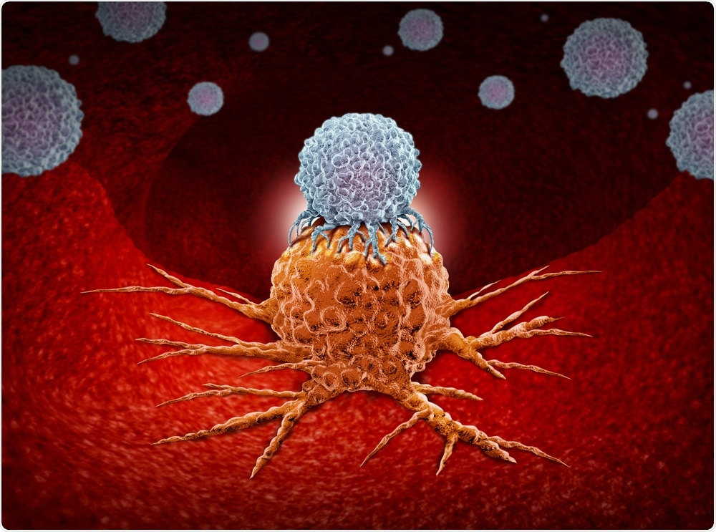
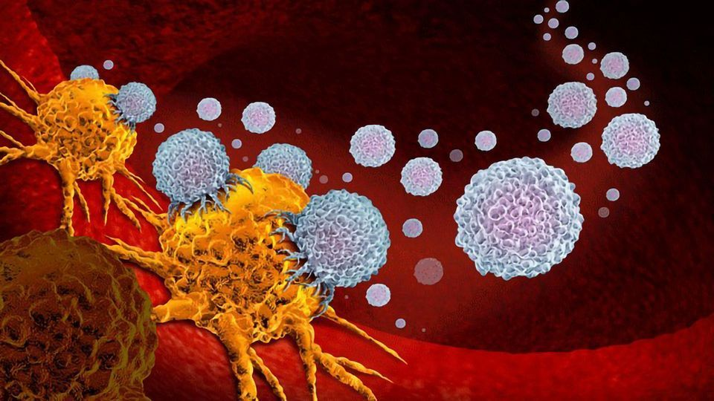
Immunetherapy:

Slide 12
Nivolumab combined with brentuximab vedotin for R/R PMBCL : a 3-year follow-up:

Slide 13
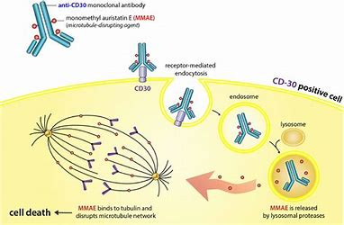
Nivolumab combined with brentuximab vedotin for R/R PMBCL : a 3-year follow-up:
The median time to response was 1.3 months, with 3.2 months to CR.
Four patients remained progression-free without subsequent HCT .
Median PFS was 26.0 months; PFS rates at 6, 12, 18, and 24 months were 63.5% , 55.5% , 55.5% , and 55.5% , respectively . Median OS was not reached; OS rates at 6, 12, 18, and 24 months were 86.3%, 79.1%, 75.5% , and 75.5% , respectively
The ORR for nivolumab plus BV in this study was also higher than the 13.3% ORR for BV monotherapy in R/R PMBL and the 48% and 41.5% ORRs for anti-PD-1 monotherapy reported in the KEYNOTE-013 and KEYNOTE-170 trials, respectively,

Slide 14
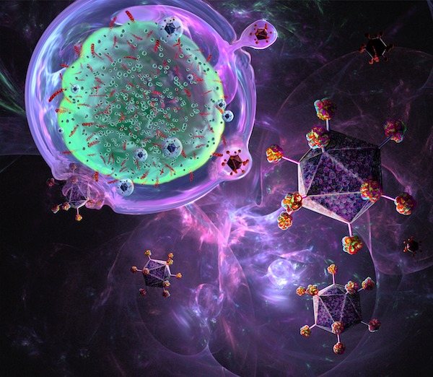
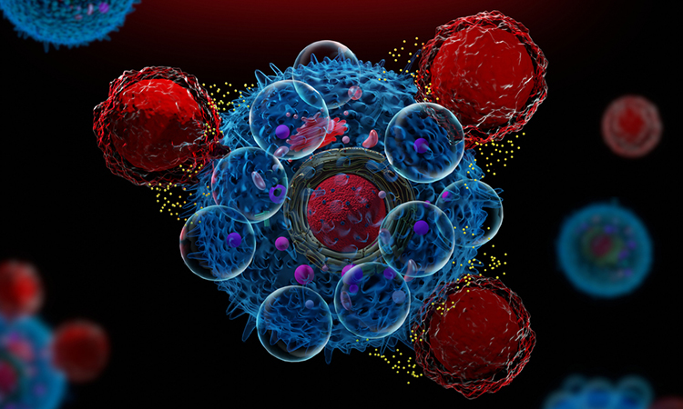
CAR-T cell therapy:

Slide 15
The excellent outcome of patients with R/R pmbcl treated with Axicabtagene Ciloleuel :
In France from October 2018 – March 2023 were included in the nation wide DESCAR-T registry.
69 patients received axi-cel (n=55) or tisla-cel (n=14). Their median follow up was 20 months. Median age was 34 years. Sex ratio (M/F) was 0.9/1.
Median number of pervious lines was 2, 6/69 patient receiving one pervious line, 7/69 patients receiving ≥ 4 lines.
Bridging therapy was administered in 58 (84%) patients, with 30/58 (52%) reaching response before CAR-T infusion.
Among patient treated with Tisa-cel(n=12), only (33%) reached CR and (33%) PR, 1y-PFS (14%), OS (49%).
EHA, Jun2024

Slide 16
Axicabtagene ciloleucel treatment is more effective in PMBCL than in diffuse large B-cell lymphomas: the Italian CART-SIE study

Slide 17
The bridging therapy was performed in more than 80% of the patients
Response to bridging was observed in 31% , with a superior ORR in PMBCL (41%) compared to other LBCL (28%).
For PMBCL, the ORR (41%) and CR (17%) after bridging ,
for other LBCL, the ORR( 28%) and CR (6%).
Patients who achieved a disease response after bridging had a better outcome compared to those not responding, with 12- month PFS of (57%) vs (45%),
and 12-month OS of (80%) vs (65%).
The CR rate at (30 days) was similar in PMBCLs and other LBCL,
but at (90 days) was superior in PMBCLs (65%) vs other LBCLs (47%), and accordingly the rate of progression at (90-day) after infusion is inferior in PMBCLs (21%) vs (40%) in LBCLs.
A median DoR not reached in PMBCLs vs median DoR of 23.64 months in other LBCLs.

Slide 18
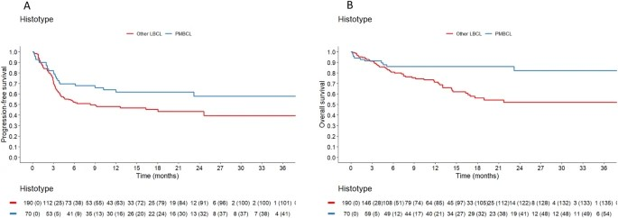
12 months PFS was 62% in PMBCL vs 48% in other LBCL.
12 months OS was 86% in PMBCL vs 71% in other LBCL.
All grade CRS was 88% , all grade neurotoxicity was 34% , with 6% of fatal events in PMBCL.
Non-relapse mortality was 3%. In conclusion, PMBCLs achieved significantly better response and survival rates than other LBCLs

Slide 19
Thank you

